Slide 1
Digital Portfolio
STUDENT NAME: VIGNESH R
REGISTER NO AND NMID: 222403567/rvignesh24138bsccs@gmail.com
DEPARTMENT: Bsc computer science
COLLEGE: sri devi arts and science college/madras university

Slide 2
PROJECT TITLE
HOTEL BOOKING

Slide 3
AGENDA
1.PROBLEM STATEMENT
2. PROJECT OVERVIEW
3. WHO ARE THE END USERS
4. TOOLS AND TECHNIQUES
5. POTFOLIO DESIGN AND LAYOUT
6. FEATURES AND FUNCTIONALITY
7. RESULTS AND SCREENSHOTS
8. CONCLUSION
9.GITHUB LINK

Slide 4

PROBLEM STATEMENT
Vignesh 5 Star Hotel needs a simple and elegant website where users can:
View hotel information.
Book a room by selecting check-in/check-out dates, number of guests, and room type.
See a booking confirmation after submitting the form.
Contact the hotel via email or phone.
The website should be easy to use, mobile-friendly, and work smoothly using only HTML, CSS, and JavaScript without a backend.

Slide 5

PROJECT OVERVIEW
Key features include:
A welcoming homepage with smooth navigation links.
A booking form where users can select check-in/check-out dates, number of guests, and room type.
Instant booking confirmation displayed on the same page.
Contact information for easy communication.

Slide 6

WHO ARE THE END USERS
Potential guests looking to booka luxury hotel stay.
Tourists and travelers seeking comfortable and elegant accommodation.
Business travelers who need premium services and easy booking options.
Anyone interested in contacting the hotel for inquiries or support.

Slide 7

TOOLS AND TECHNIQUES
HTML5: To structure the web content and create semantic sections like header, booking form, and contact.
CSS3: For styling the website with custom fonts, layouts, colors, and responsiveness.
Google Fonts: Used Playfair Display and Roboto fonts to enhance the typography and overall design.
JavaScript: To handle form submission, provide smooth scrolling, and display booking confirmation dynamically.
Responsive Design Techniques: Ensuring the website works well on different devices and screen sizes.
Browser Developer Tools: For debugging and testing the website during development.

Slide 8
POTFOLIO DESIGN AND LAYOUT
Header: Includes the hotel name and a navigation menu with links to Home, Booking, and Contact sections for quick access.
Hero Section: A welcoming banner with a headline, a brief description, and a prominent “Book Now” button that smoothly scrolls to the booking form.
Booking Form: A well-organized form with labeled inputs for check-in/check-out dates, number of guests, and room type, followed by a confirm button. The form includes an instant booking confirmation message after submission.
Contact Section: Displays contact details such as email and phone number in a simple format, making it easy for users to get in touch.
Footer: Contains copyright information and maintains a consistent style with the rest of the site.
8

Slide 9
FEATURES AND FUNCTIONALITY
Header – Shows the hotel name and menu (Home, Book Now, Contact).
Welcome Section – A nice welcome message with a button to book.
Booking Form – Lets users:
Pick check-in and check-out dates
Choose number of guests
Select room type
Click to confirm booking
Confirmation Message – Shows booking confirmed after form is submitted.
Contact Info – Shows email and phone number.
Footer – Has copyright info.
Uses CSS & JavaScript – For styling and form actions.

Slide 10
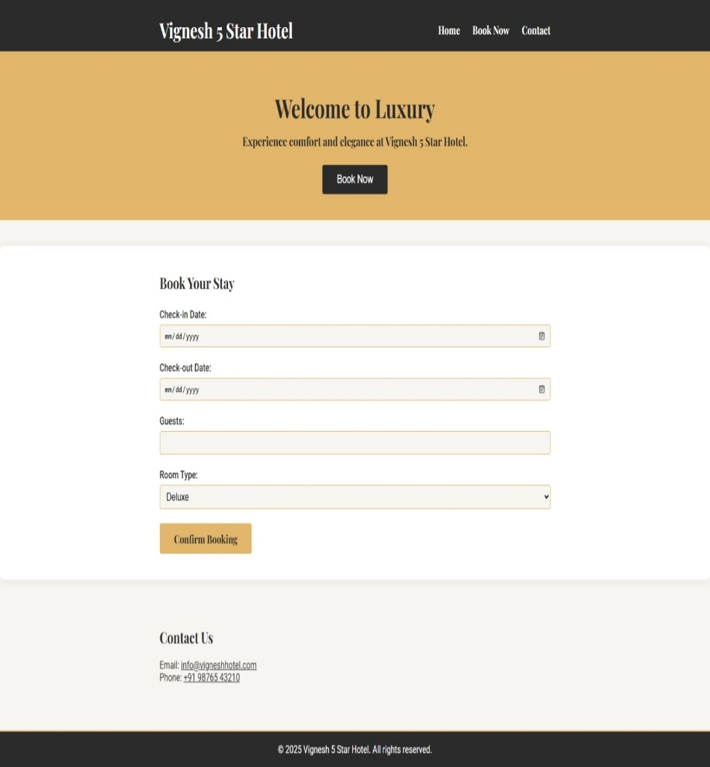

RESULTS AND SCREENSHOTS
The hotel website is working successfully.
Users can:
See the hotel name and welcome message.
Click Book Now to scroll to the form.
Fill in booking details (dates, guests, room type).
See a booking confirmation after submitting the form.
View contact information (email and phone).
The design looks good on both computers and mobile phones.
3/21/2024 Annual Review
10

Slide 11
CONCLUSION
The Vignesh 5 Star Hotel website was successfully created using HTML, CSS, and JavaScript. The website includes important sections like a welcome page, booking form, contact information, and a confirmation message.
It is user-friendly, works well on mobile and desktop, and allows users to book a room easily. The project helps in understanding how to build a basic, functional hotel booking website.
This project shows how front-end web development can be used to create real-world applications.
11

Slide 12
Github link
https://github.com/rvignesh24138bsccs-sys/vignesh_24138.git

